Slide 1



Hackathon: Escape Room
Team Members
Ben Miller
Carmen Vieira
Maria Gadkova

Slide 2
Hackathon: Escape Room
Lessons Learned
What Went Well
We managed to create a working project with the use of git/github/scratch.
Our Plan follows the basic flowchart principles that we set up.
We communicated clearly in terms of git stage, pull, commit, push actions and resolved any issues.
Room for Improvement
We struggled with keeping a concrete plan, especially when making the demo: got sidetracked.
We should have had more structure to allow the team members to work in the different sections (like the demo).

Slide 3
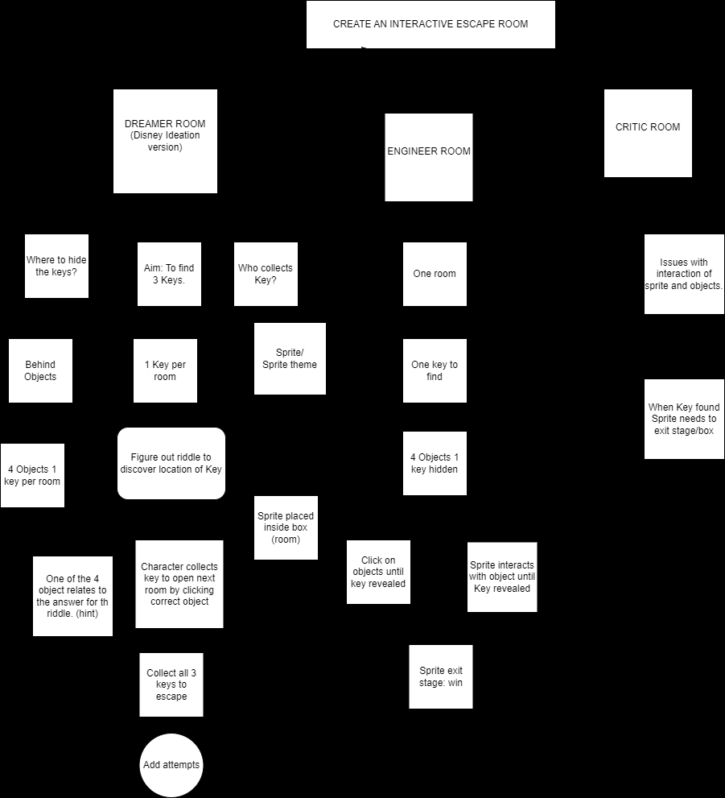
Hackathon: Escape Room
Flow Diagram

Slide 4
Hackathon: Escape Room
DEMO

